Slide 1
Design Rule check

Slide 2
Design Rules
Substrate thickness: recommendation ~300µm
Mold material: Hitachi GE100LFCS-K
Mold cap thickness: 670µm
Topology in die attach area max ~10-20µm
Topology in wire bond area <10µm
Package Outline check
Dicing kerf in layout 220µm = dicing blade widths 220µm (Backup: 200µm blade widths)
50µm line in ficucial okay
Dicing kerf – check with Maciej
Adhesion of mold compound
Solder Stop area as big as possible to get a good mold ahesion
Risk of „leakage“,...
Avoid dicing through metal within PCB layer stack
Dicing kerf in layout 220µm -> Metal pull back 80µm → 300µm metal free zone in dicing kerf → 40µm on each side
Bonding
No via hole allowed in (wire) bond area
LFBGA fiducial – template from LFBGA 160-2
Dicing fiducial adapted to =150µm layout dimension (otherwise higher costs)
Accretech dicer is checking 300x400µm windows to adjust dicing channel
PIN1 on device / PIN1 on substrate

Slide 3
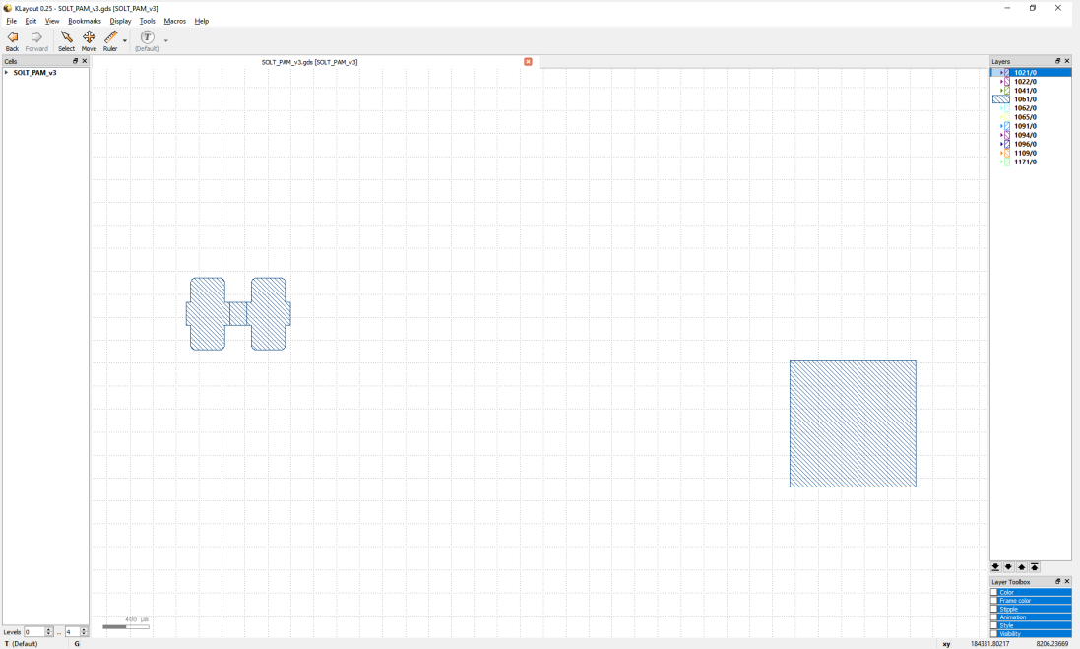
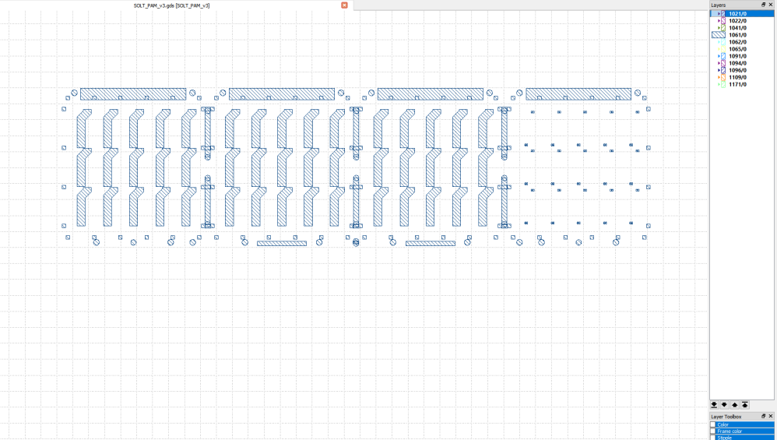
Layout from Maciej Jankowski

Slide 4
LFBGA Assembly Process @ RBG Fast Prototyping
Single layout by IFX
PCB layout done by HLP
Requirement for PCB to do BE assy? Passives attached at HLP
Shipment from Hofmann Leiterplatten RBG
Die-attach
Wirebond
Molding
Laser marking
Singulation
A
Die-attach
Material: Loctite hybrid silver 8068TB (must)
Bond line thickness: 10-25µm
Wirebonding
25µm Au wire - ball on stitch (Chuck!?)
B
Molding
Material: Hitachi GE100LFCS-K (must)
Transfer mold – use existing mold tooling
0.8mm/0.9mm mould cap
RBG Assy
C
Laser Marking
Serialisation/Identification of individual parts
DoE variants
D
Singulation
Dicing blade/parameters
Blade width 240µm
Shipment: Frame

Slide 5
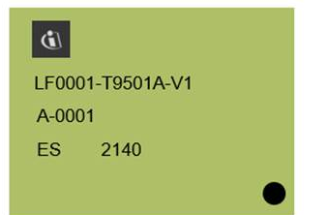
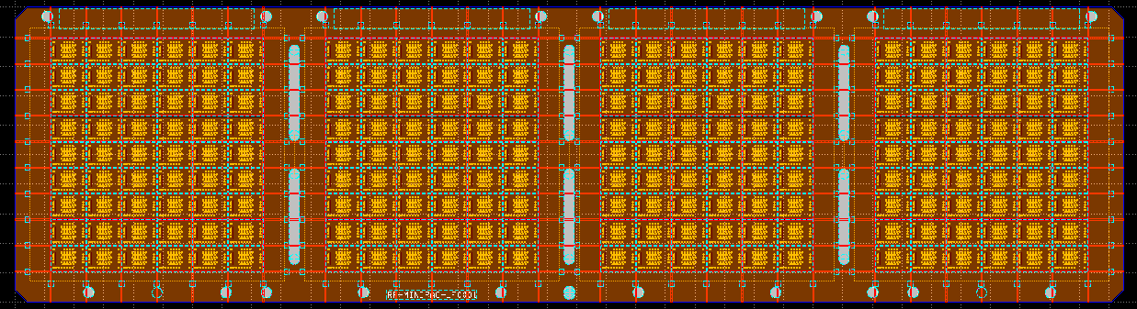
RF-MINIPAC T9501A - Laser Marking
Laser Marking Pattern
1. row: PIN 1 orientation! + Infineon
2. row: “LF0001-T9501A-V2” → [Leadframe Version]-[Die Basictype]
3. row: “A-0001” → [Panel Section]-[Unit Count]
4. row: “ES” + “Date code”
LF0001-T9501A-V2
A-0002
ED 2140
Panel Section ID
187.5mm
216 pieces per panel
4x9x6
A
B
C
D
50mm
PIN1 marking soldering side → corner cut available
Bottom right

Slide 6
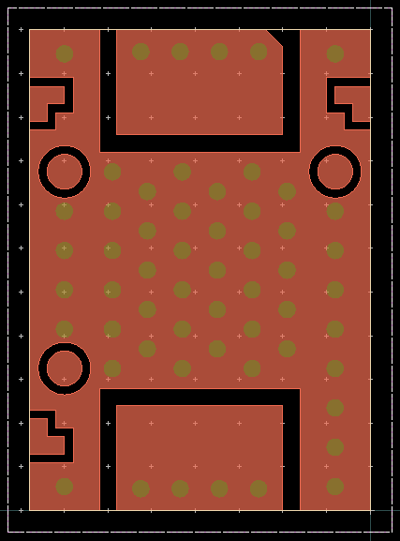
PIN1 on device

